Slide 1
T1D in vitro data explorer

Slide 2
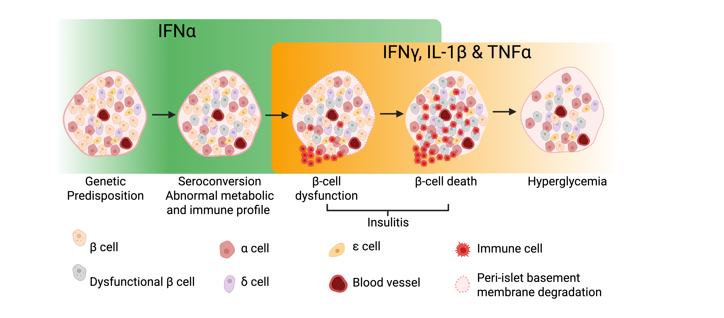
T1D disease modeling

Slide 3
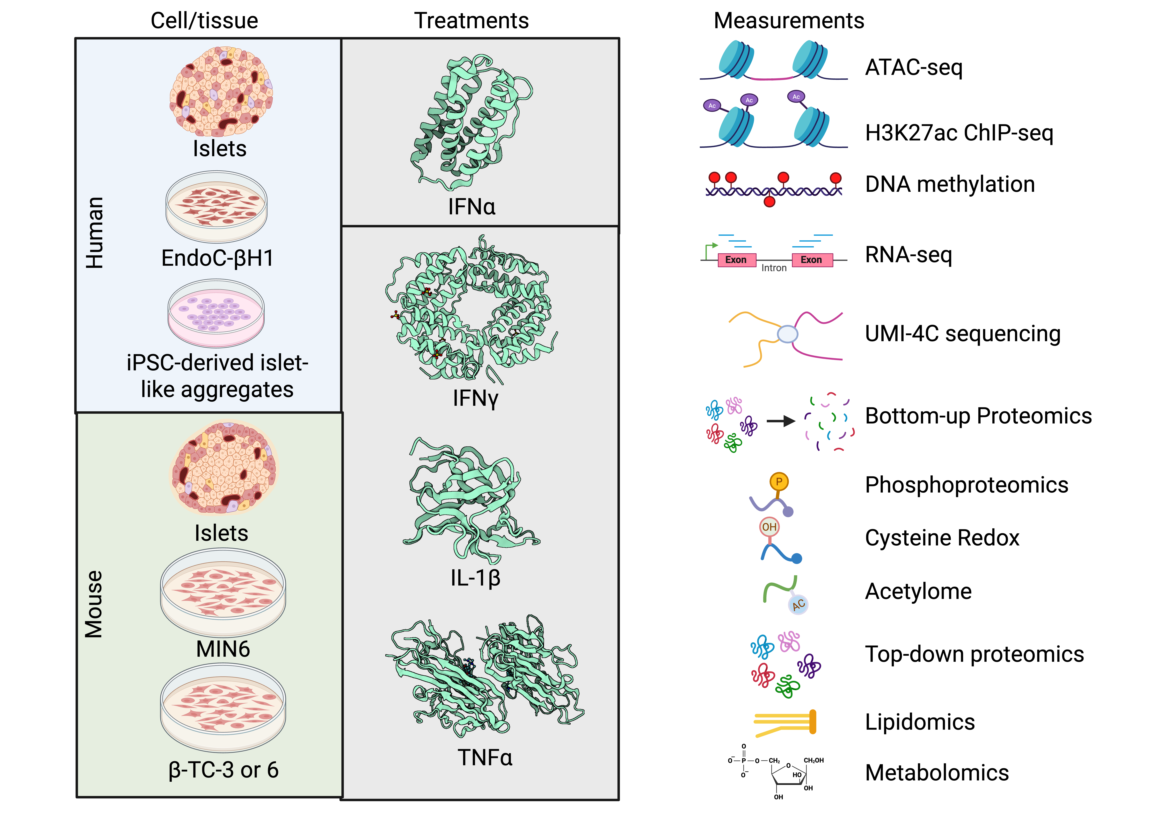
Curated in vitro datasets

Slide 4
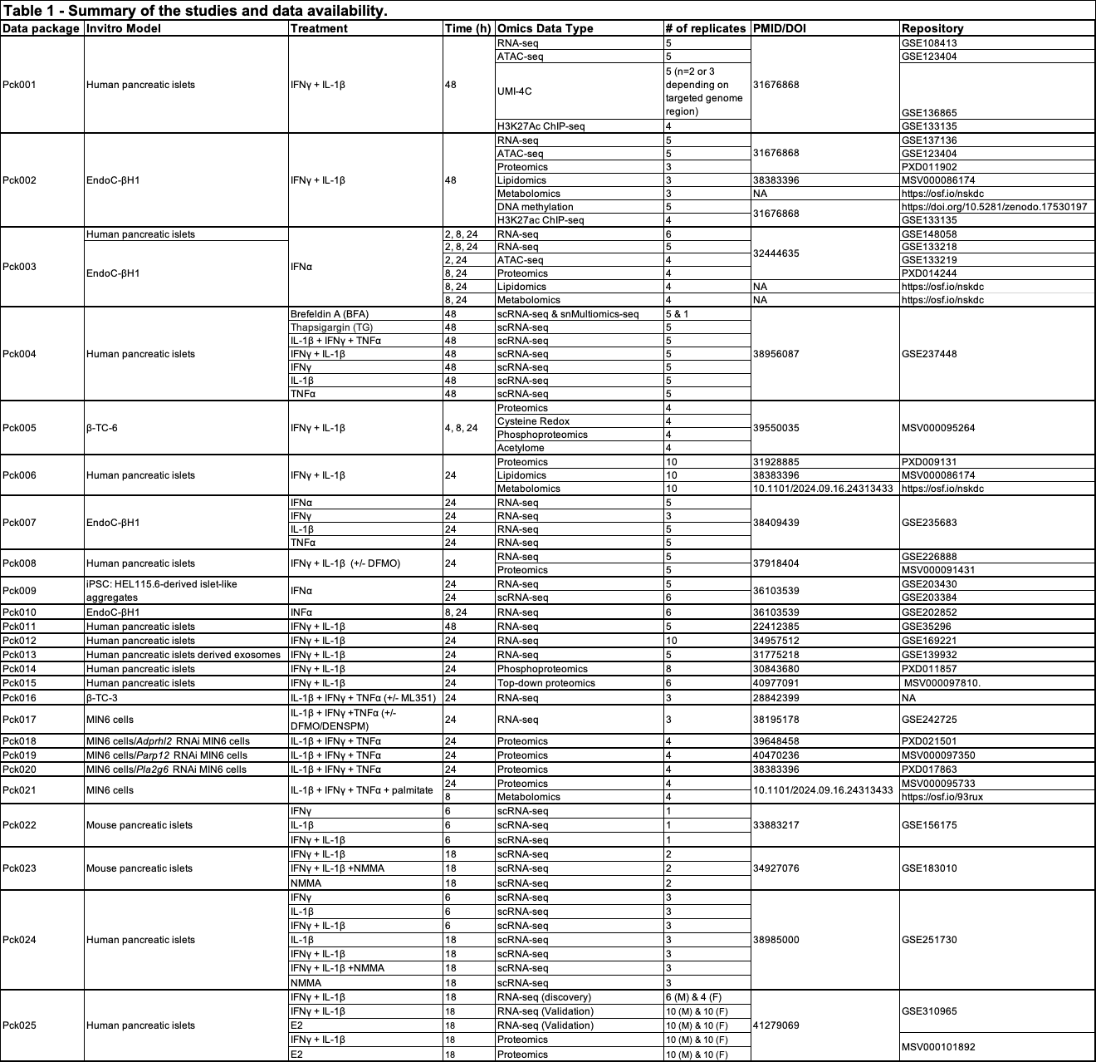
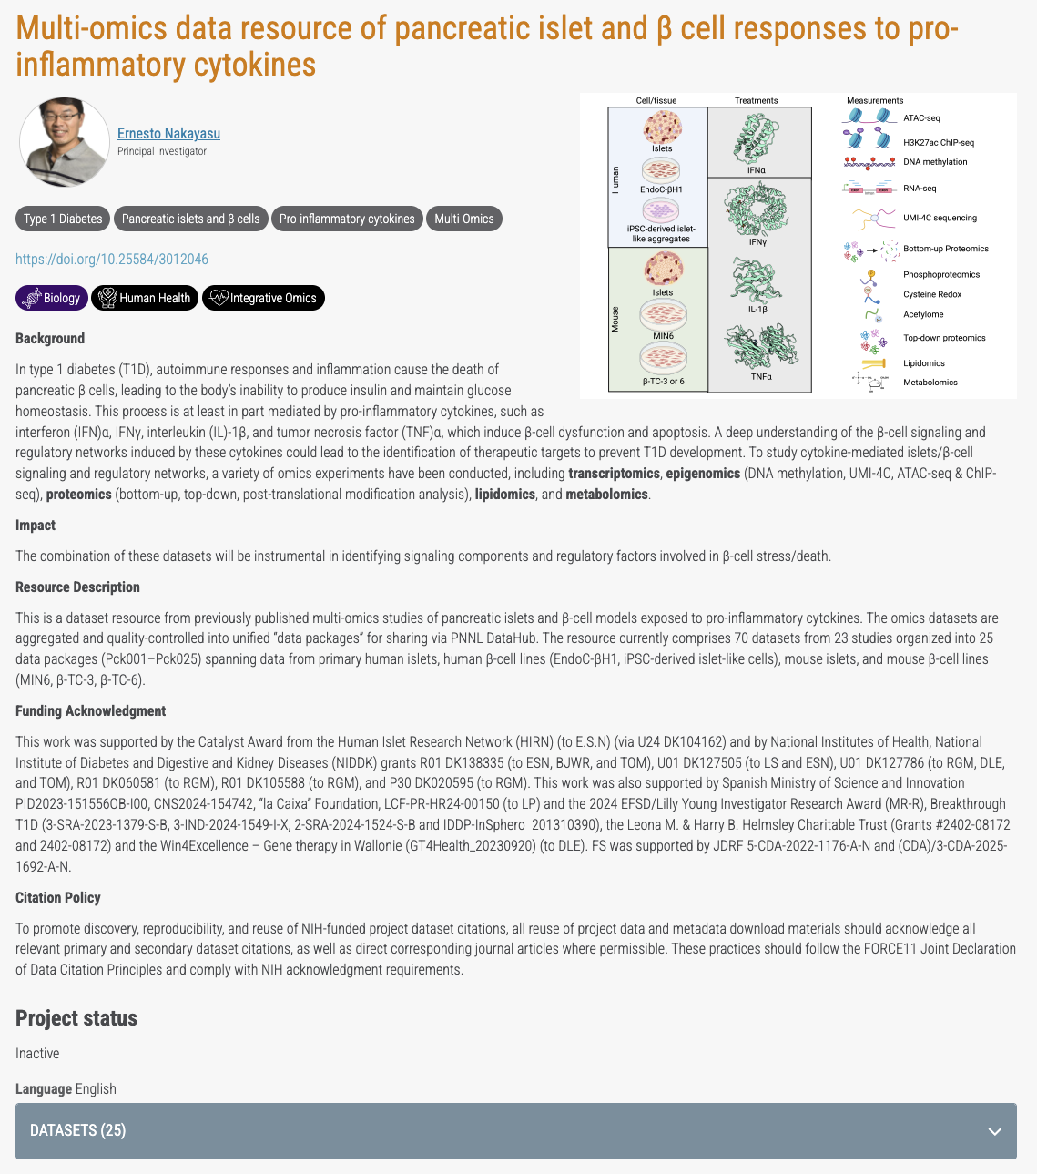
DATAHUB repository

Slide 5
Rational for an application
The data are housed together, but are not in a format that is easily accessible and searchable.
There are variety of data types, in vitro models and treatments that when visualized together could provide a deeper understanding of the chnages of a particular gene or protein during the disease manifestation.

